Slide 1
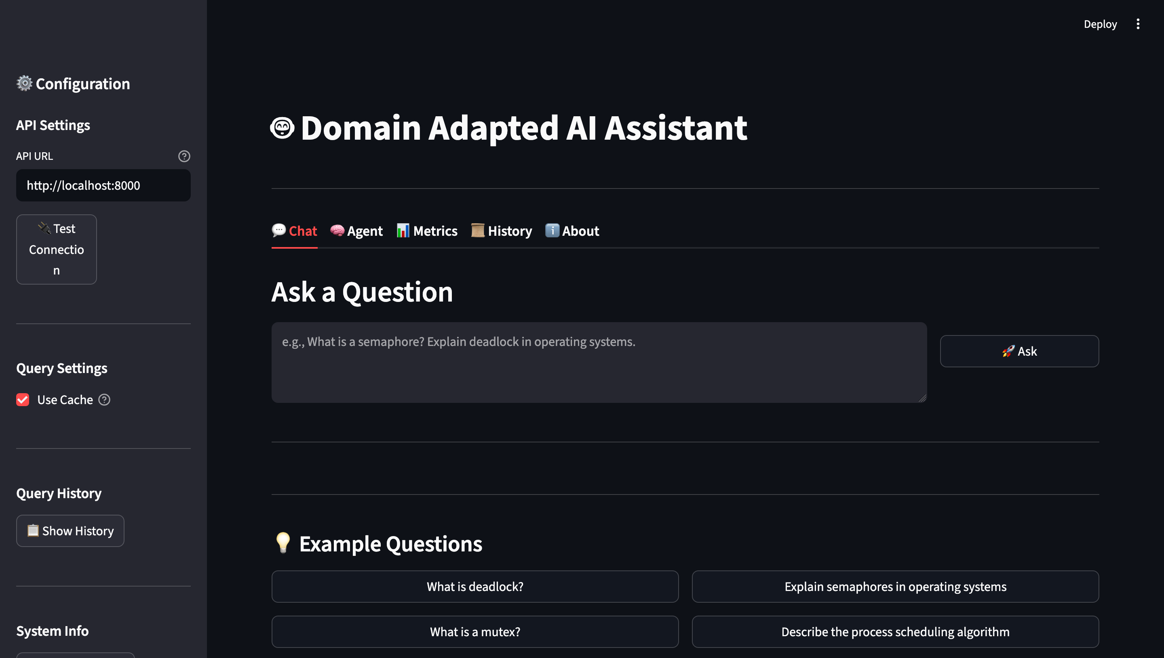
A Domain-Adapted AI Assistant for Operating Systems Question Answering
Ibrahim Alborno, Immanuel Olaoye University of Missouri–Kansas City, CS 5542
Problem Statement / Motivation
System Architecture / Pipeline
General-purpose AI systems often produce answers that are too broad, inconsistent, or not well-focused for specific academic domains. In operating systems education, students benefit from responses that are more accurate, structured, and relevant to technical concepts. This project addresses that problem by adapting an AI assistant to answer operating systems questions more effectively.
The workflow of the system begins with an operating systems instruction dataset. That dataset is used in a LoRA-based fine-tuning process to adapt the model to the target domain. The adapted model is then connected to a FastAPI backend, which communicates with a Streamlit frontend for user interaction. Additional support for logging, monitoring, evaluation, and reproducibility helps improve the reliability of the final system.
Dataset Description
Instruction Dataset
LoRA Fine-Tuning
Adapted Model
FastAPI Backend
The project used an instruction dataset stored in dataset/instructions.json. The dataset contains question-answer examples focused on operating systems topics such as deadlock, scheduling, memory management, synchronization, and process behavior. This dataset was used to help adapt the model to produce more domain-specific responses.
Logging, Monitoring, and Evaluation
Streamlit Frontend
Conclusion & Future Work
This project demonstrates that domain adaptation can improve the quality of AI-generated responses in a specialized academic area without requiring full model retraining. By combining LoRA fine-tuning with a Streamlit frontend, FastAPI backend, and support for evaluation and monitoring, the system became more useful and reliable for operating systems question answering. Future work could include expanding the dataset, improving evaluation metrics, and extending the system to additional computer science domains.
Methodology / Approach
The system combines a Streamlit frontend, a FastAPI backend, and a LoRA-based fine-tuning process. First, an instruction dataset was prepared using operating systems question-answer pairs. Then the model was adapted using LoRA fine-tuning. After training, the adapted model was connected to the FastAPI backend and Streamlit frontend so users could interact with the system. Logging, monitoring, evaluation, and reproducibility improvements were also added to strengthen the final application.
Results & Evaluation
After domain adaptation and system integration, the application produced responses that were more structured, more relevant to operating systems topics, and more consistent than general baseline responses. The addition of backend integration, logging, monitoring, and evaluation support also improved reliability and stability during testing. These results show that domain adaptation can improve the usefulness of an AI assistant in a targeted educational setting
Demo / Application
Questions?
The final application allows users to enter operating systems questions through a Streamlit interface and receive domain-adapted responses through a FastAPI-connected backend. The system demonstrates how a domain-focused AI assistant can support learning by delivering clearer and more relevant answers to academic questions. The demo highlights the end-to-end workflow from user input to generated response.

